Slide 1
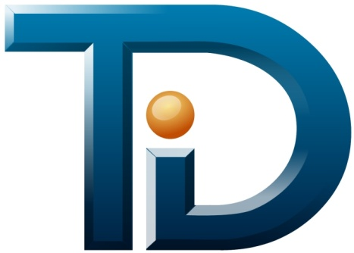
The Defense Inside
How to protect your business
The Global Leader in
IT Foundation Management
Notes:
1

Slide 2



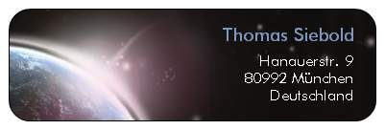
Thomas Siebold
32 years of experience in IT
Companies
  Digital Equipment GmbH
  Digital Equipment Corporation
  Compaq Computers EMEA
  Hewlett Packard EMEA, GmbH
Now free lance technology consultant (S.IT.CO)
Reseller and Service provider for TDi (D, A, CH)
sitco.biz@gmail.com
www.sitco-consulting.biz

Slide 3
Tdi Technologies
Founded by Bill Johnson
Headquarter in Dallas, TX Metroplex
In business >20 years
~300 Customers, 3200 Installations
Privately Held
Profitable and Growing
Numerous awards as a high-growth technology company
www.tditechnologies.com

Slide 4
Agenda
Introductions
Terminology
IT Foundation Management Suite
  Defense Foundation
  IT Operations Foundation
  IT Services Foundation
  Compliance Foundation
  Virtualization
Technology
References
Questions

Slide 5
Terminology

Slide 6
Insider Threat
    Think about:
    BP Gulf Oil Spill
    BP's Chief executive Tony Hayward (The Financial Times)
  …it was "an entirely fair criticism" to say the company had not been fully prepared for a deepwater oil leak…
Hayward called it "low-probability, high-impact" accident.
He also said:
  "What is undoubtedly true is that we did not have the tools you would want in your tool-kit«
What will you say when you didn’t have the tools in your toolkit to deal with a «Low Probability, High Risk" breach to your business.
=> Let’s have a look at what TDI can provide for your tool box!

Slide 7
Insider – What ?
Insider
  is someone who has legitimate access to an organization, its systems, information or other resources.
Insider threat
  is a risk that an insider can misuse their access or knowledge to cause harm to the organization/business.
Insider weakness
  where an insider performs unsafe actions or fails to apply adequate protection that may expose the organization to accidental damage or malicious attack.
Notes:
Person who forgot the IPHONE 4 prototype in a bar

Slide 8

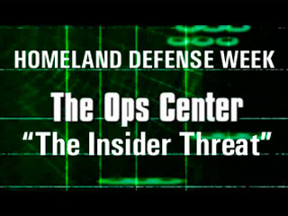
Who is the Insider ?
Security Guards
System Administrator
Operators
Former Employees
Contractors
Consultants
Suppliers
Visitors
Partner Employees

Slide 9
Insider Threat – So what !?
Information Security Group, London:
  68% of respondents said that it is the biggest threat to their intellectual property and other sensitive data
    http://www.isg.rhul.ac.uk/
Carnegie Mellon University’s COMPUTER EMERGENCY RESPONSE TEAM (CERT)
2010 CYBERSECURITY WATCH SURVEY:
  51% of respondents still victims of an insider attack, despite previous experience
  Remains constant with previous two surveys in 2007 and 2006
  67% of respondents: Insider incidents more costly than external breaches
    http://www.allbusiness.com/crime-law/criminal-offenses-cybercrime/13781867-1.html
    http://www.cert.org/insider_threat/
Notes:
Carnegie Mellon University's Computer Emergency Response Team.
www.cert.org

Slide 10
Insider Threat – So what !?, cont‘d
US Secret Service & Carnegie Mellon University Survey:
  Most insider events triggered by a negative event in the work place
  Most perpetrators had prior disciplinary issues
  Most insider events were planned in advance
  17% of the insider events studied involved individuals with root access
  87% of the attacks used very simple user commands that didn't require any advanced knowledge
  30% of the incidents took place at the insider’s home using remote access

Slide 11
Insider Threat – Remember ??
19-eighties
Kevin Mitnick
Digital Equipment Corporation
gained acces by asking a system administrator for the password using a false name

Slide 12
ConsoleWorks® ITFM (IT Foundation Management) Suite

Slide 13
ConsoleWorks® ITFM (IT Foundation Management) Suite
  Defense Foundation Trust is NOT enough
    Secure the Foundation (insiders)
    Detect, alert, respond
    Verify with auditable history
  IT Operations Foundation
  Doing More with less
    Universal, integrated environment•
    Optimized, automated process •
    Secure, remote management•
DEFENSE
IT OPERATIONS
VIRTUALIZATION
ConsoleWorks® ITFM Suite
COMPLIANCE
FOUNDATION
IT SERVICES
  Compliance Foundation
  Meeting Intent & Interpretation
    Control subsystems changes
    Detect compliance events
    Build auditable history
  IT Services Foundation
  Delivering the Promise
    Sense and Respond in real-time•
    Correlate across the architecture•
    Proactively manage and protect•
Notes:
IT Foundation Management software from TDi Technologies delivers value in that gap in five areas:
Defense against the Insider Threat through foundation security and auditable records generation
Compliance within the infrastructure for Compliance Incident avoidance and for Auditing
Optimization and automation of IT Operations that increases reliability and availability while reducing costs
The ability to proactively monitor and manage the delivery of IT Services against Service Level Agreements and other KPIs
And the ability to extend this benefits to Virtualization technologies and Cloud Computing

Slide 14


Traditional Approaches have a Blind Spot
CORPORATE NETWORK
LOG FORWARD REQUIRES:
Operating System
Network Services
Active Network Connection
Blind Broadcast
AGENT-BASED REQUIRES:
Operating System
Network Services
Active Network Connection
Installed Agent
COMPONENT ARCHITECTURE
agent
COMPONENT ARCHITECTURE
PROGRAM(S)
PROGRAM(S)
OPERATING SYSTEM
OPERATING SYSTEM
BLIND SPOT
Notes:
In contrast, traditional approaches use either log forwarding or they install agents on devices.
In these traditional approaches, devices that are not actively on the production network effectively “disappear” from the management view.
It’s like cutting the main communication line.
Traditional approaches have NO visibility into IT devices that are not actively on the production network.

Slide 15
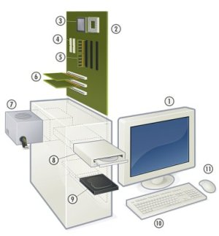
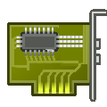
The Blind Spot – Physical Serial Interfaces on Hardware Devices Explained
Where is it?
Inside devices, physically on or connected to the motherboard
What is it?
Physical hardware
Independent operation
Specialized interface used for:
  setup
  configuration
  applying patches
  maintenance
  repair
What Devices?
Servers
SANs
Racks
Routers
Switches
(many more)
Why is it important?
It provides master access to its Host’s hardware and software
Notes:
*Note – this slide is primarily here to “connect the dots” if someone has a hard time understanding what and where a “serial interface” is! This slide is completely optional.
Serial interfaces are hardware that is either embedded directly into the motherboard of an IT device or that attach to the motherboard. Serial interfaces have been included in almost every IT device manufactured since 2005.
The serial interface is “live” any time there is power to the chassis of the device – even when the device is “turned off.” Serial interfaces are used for initial configuration, reconfiguration, maintenance, troubleshooting and repair.
Serial interfaces are very important because they provide the highest level of authority to a device. Through a serial interface connection, you can change BIOS, load operating systems, install drivers, provision hardware – and everything else that the device is capable of doing! Serial interfaces are sometimes called service ports or service processors, because they are often used to perform device servicing. They may also be called “baseboard management controllers” along with many vendor-specific names such as ALOM, ILO and DRAC.
A common example of a serial interface that most of us can relate to is a home router. Home routers have an internet or wan port that also acts as the serial interface to the router. If you are physically connected to this interface with a computer, you can log onto the routers serial console and change any settings on the device – including disabling security. The main difference is that IT devices have separate physical ports for this function.
*optional* As a side note, have you ever considered the ramifications of home internet when the “technician” comes in and sets up your service? They go into that serial interface and setup the router, and while they are there they could easily add a computer address into your router that would give the computer with that address access to your internet connection and your home network! This is a simple example of the security vulnerability of these serial interfaces that will be discussed in more detail later in this presentation.

Slide 16

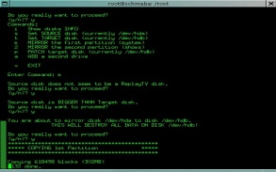
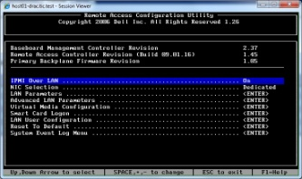
IT Foundation Management builds from the bottom-up, closing the gap
CORPORATE NETWORK
DOESN’T REQUIRE:
Operating System
Network Services
Active Network Connection
COMPONENT ARCHITECTURE
PROGRAM(S)
OS CONSOLE
ELIMINATES BLINDSPOT BY:
Capturing Serial Console Events
Capturing Extended OS Events
Capturing Console Actions (serial & OS)
Securing consoles (role-based security model)
Closing Incident Management Loop
Maintaining control in ALL OPERATING MODES
SERIAL CONSOLES
OS Console
Serial Console
IT FOUNDATION NETWORK
Notes:
So how does IT Foundation Management bridge this gap?
IT Foundation Management is a bottom-up approach to infrastructure management
that uses active connections to the privileged serial interfaces to eliminate this blind spot,
This bottom-up approach eliminates the blind-spot caused by reliance on the normal production network for monitoring activities,
a blind spot that exists every single time any device is not on the production network; a routine occurrence during configuration, repair, maintenance and reconfiguration
Bridging this gap presents new opportunities to do more with less and to create new business value.

Slide 17
ConsoleWorks® Defense Foundation
  Defense Foundation Trust is NOT enough
    Secure the Foundation (insiders)
    Detect, alert, respond
    Verify with auditable history
  IT Operations Foundation
  Doing More with less
    Universal, integrated environment•
    Optimized, automated process •
    Secure, remote management•
DEFENSE
IT OPERATIONS
VIRTUALIZATION
ConsoleWorks® ITFM Suite
COMPLIANCE
FOUNDATION
IT SERVICES
  Compliance Foundation
  Meeting Intent & Interpretation
    Control subsystems changes
    Detect compliance events
    Build auditable history
  IT Services Foundation
  Delivering the Promise
    Sense and Respond in real-time•
    Correlate across the architecture•
    Proactively manage and protect•
Notes:
The first area of business value is Defending against the Insider Threat with the Defense Foundation.

Slide 18
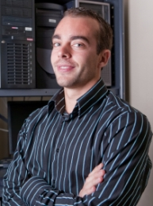
ConsoleWorks® Defense Foundation – Defending against the Insider Threat
Who has access to the master control interfaces on your hardware?
Who… including employees, contractors, service technicians…?
What they have brought in, and what they have taken out?
What can they DO?
Have they been compromised?
What authority do these interfaces have?
(Senior Engineer)
“I can do ANYTHING I want.”
What have they DONE?
Are they angry? Tired? Stressed?
Notes:
When it comes to the Insider Threat, there is no one more “inside” than the people who maintain your IT Infrastructure.
Traditional approaches turn a blind eye to these insiders leaving no real answers to questions like:
Who has access to the master control interfaces on your hardware? Employees? Contractors? Service Techs? Vendors?
Do you know what they have done, or not done?
Could they be subject to an emotional stress? Perhaps disgruntled? Passed over for promotion? No raise? Overworked (at least in their opinion)?
Could they be compromised? (like a usb stick “left” at their favorite table in Starbucks)
Do you realize the power they have? That through these master interfaces, they can do ANYTHING?
FOR YOUR REFERENCE:
Background on one usb stick example - A recent study concluded that leaving a usb stick at a café or coffee shop like Starbucks is almost certain to end up with the usb stick being taken by someone. The first thing that someone does with it? Plug it in and see what’s on it – and when they do they are compromised. If the usb is a plant (and this is a documented attack strategy) then malware is likely to be introduced internally within the IT infrastructure. Compromising Insiders only takes a creative and determined outsider for the threat to be all to real.

Slide 19
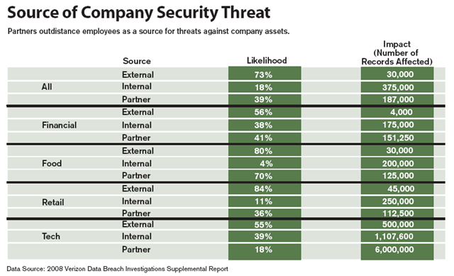
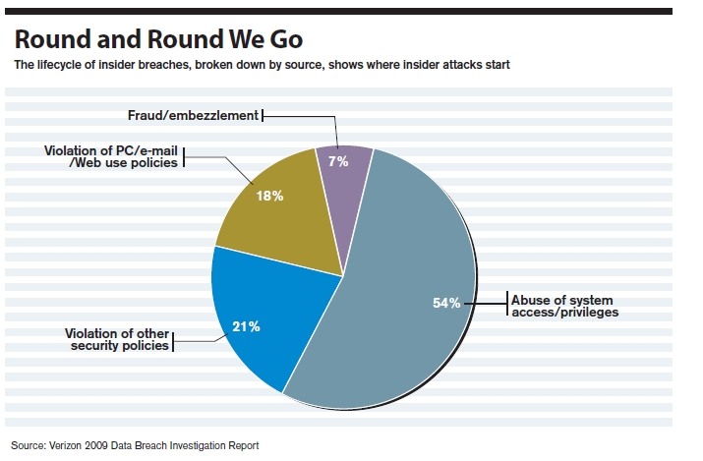
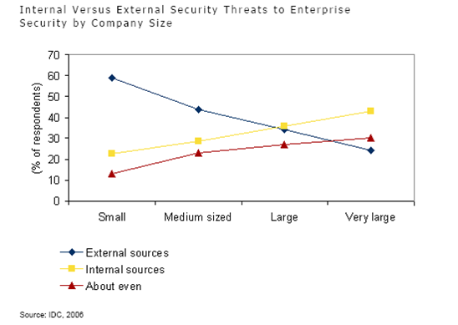
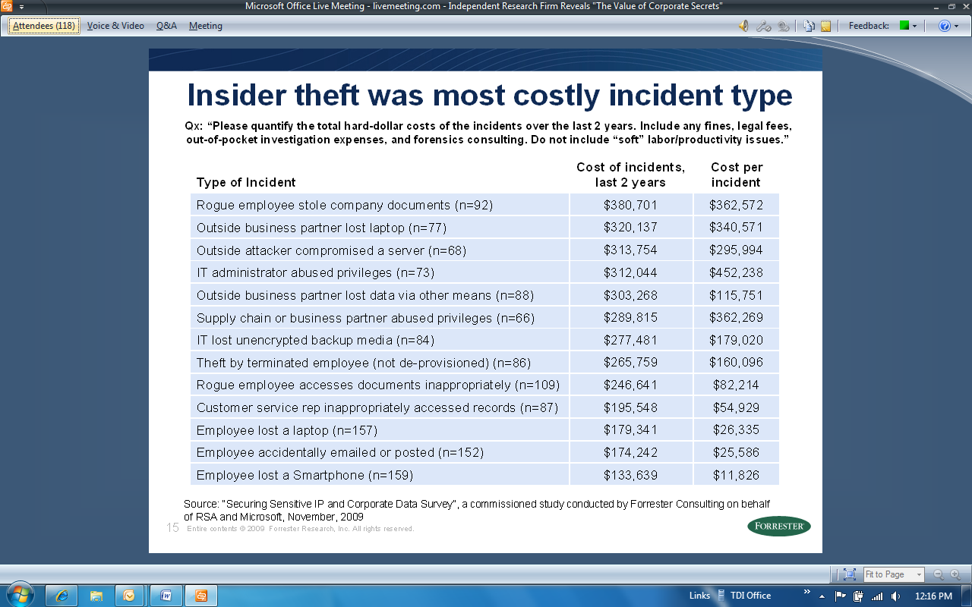
What does the ConsoleWorks® Defense Foundation Defend against?
Insider Threat Demographics
Defense Foundation Coverage
Defense Foundation Defends against
System privilege abuse - 54% of all insider breaches
Insider Impact: 10x greater
Insiders impact more than 10x as many records per Incident
Insiders are Greatest Threat
6 of top 8 Threats Defended against
by the Defense Foundation.
Average cost per Incident = $302,000 USD
…in very large enterprises: double (2x) that of outsiders!
Notes:
THIS SLIDE HAS FOUR (4) “ON CLICK” ANIMATIONS
BEFORE CLICK: The ConsoleWorks Defense Foundation helps to defend against specific Insider Threats that have a very high cost associated with them.
FIRST CLICK: In fact, based on a study by Verizon, the impact per Incident of Insider Threats is more than 10 times that of outsider threats
SECOND CLICK: IDC notes that while we typically think of outsider threats being the most prevalent, insiders are by far the greatest threat to very large organizations – over double that of outsiders!
THIRD CLICK: The most prominent threat? System privileges abuse - accounting for over half of all the insider breaches!
This is one of the primary threats that the Defense Foundation helps to defend against
FOURTH CLICK: Analyst Firm Forrester quantified the “most costly” insider threats, and the Defense Foundation helps defend against 6 of the top 8 threats.
The average cost of those threats is $302,000 per Incident.

Slide 20
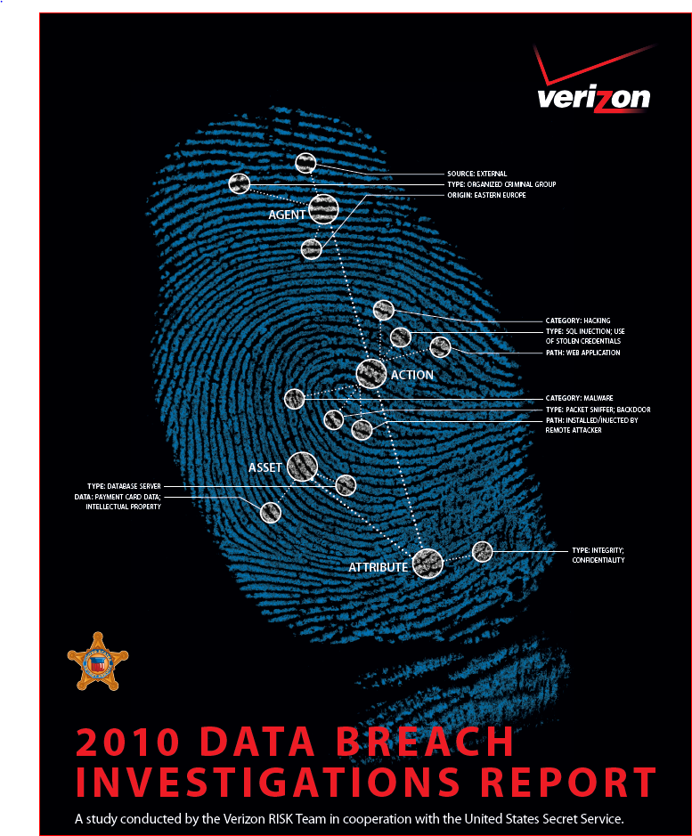

Slide 21
VERIZON Data Breach Report 2010
2010 DATA BREACH INVESTIGATIONS REPORT
A study conducted by the Verizon RISK Team in cooperation with the United States Secret Service.
WHO IS BEHIND DATA BREACHES?
70% resulted from external agents (-9%)
48% were caused by insiders (+26%)
11% implicated business partners (-23%)
27% involved multiple parties (-12%)
(http://www.verizonbusiness.com/resources/reports/rp_2010-data-breach-report_en_xg.pdf)

Slide 22
ConsoleWorks® IT Operations Foundation
  Defense Foundation Trust is NOT enough
    Secure the Foundation (insiders)
    Detect, alert, respond
    Verify with auditable history
  IT Operations Foundation
  Doing More with less
    Universal, integrated environment•
    Optimized, automated process •
    Secure, remote management•
DEFENSE
IT OPERATIONS
VIRTUALIZATION
ConsoleWorks® ITFM Suite
COMPLIANCE
FOUNDATION
IT SERVICES
  Compliance Foundation
  Meeting Intent & Interpretation
    Control subsystems changes
    Detect compliance events
    Build auditable history
  IT Services Foundation
  Delivering the Promise
    Sense and Respond in real-time•
    Correlate across the architecture•
    Proactively manage and protect•
Notes:
Now let’s look at how the IT Operations Foundation helps meet the challenge of doing more with less.

Slide 23
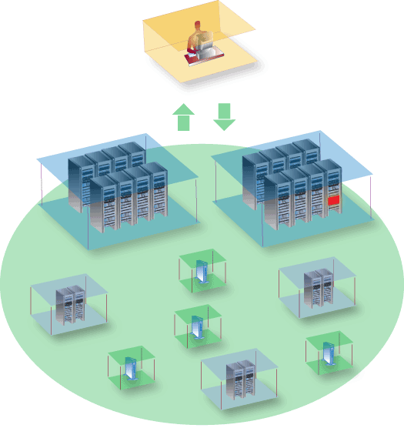
Typical Infrastructure Outage
Systems/Network Management
Assets not available
due to:
OS failure
Configuration error
Hardware problem
Other problem
Monitor & Control
IT Asset
Outage
To fix: Local Administration
- Walk
Drive
Fly
3rd party

Slide 24

ConsoleWorks® IT Operations Foundation – Would you benefit from…
DOING MORE WITH LESS?
Reducing IT support costs by 50% +?
Decreasing complexity?
Improving efficiency by an order of magnitude?
Increasing your agility and flexibility?
Providing greater systems reliability?
Leveraging the domain knowledge of your experts?
Fixing things right – the first time?
Notes:
The benefits listed here deliver on the promise of doing more with less.
We work very closely with our customers, and these are the common benefits our customers have told us they get from our IT Operations Foundation software.
They are practical benefits that help deliver more of what the business needs, while at the same time reducing the associated costs of that delivery.

Slide 25

Why does the ConsoleWorks® IT Operations Foundation reduce cost?
Detect
  Data «on change» from serial interfaces AND log files
  Automatic processing and prioritization
Diagnose
  Vendor descriptions via Intelligent Event Modules
  Correlation across infrastructure levels
Remediate
  One-click opening of consoles for remediation
Universal, secure, remote access
  Spans device/ people locations seamlessly with real-time collaboration
1
With « on change » detection and
2
Intelligent Prioritization + Diagnosis
3
my productivity is quadrupled.
Notes:
The four things that the ConsoleWorks IT Operations Foundation does to achieve these results are:
Improving the detection of important events
The IT Operations Foundation captures more events than traditional practices and captures all events when they actually happen (in milliseconds)
Then it automatically processes those events, including assigning the appropriate event prioritization
2) Increasing the speed and accuracy of incident diagnosis
The IT Operations Foundation has Intelligent Event Modules that automatically associate vendor definitions and best practice remediation to events.
In addition, root cause correlation for analysis becomes available across all infrastructure levels covered by the IT Operations Foundation
3) Much simpler path to remediation
IT infrastructure is so complex that it often becomes challenging to identify the asset that needs remediation, and then establish a connection to that asset.
The IT Operations Foundation abstracts users from these challenges by doing the work for them, empowering them to access the right asset with a single mouse click.
4) Finally, there are no geographical limitations
The IT Operations Foundation securely spans asset and people locations seamlessly, with real-time collaboration to leverage the power of virtual teams and teamwork.

Slide 26
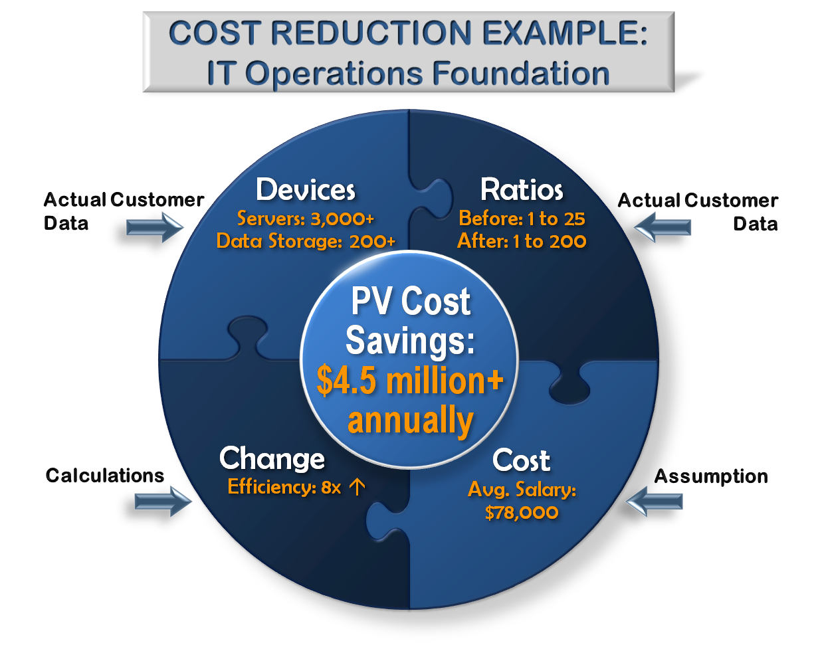
Example –Client Cost Savings with the ConsoleWorks® IT Operations Foundation
6 month payback on investment
Actual Data – Devices being managed
Servers = 3000+
Storage Devices = 200+
Actual Data – Engineers to devices
BEFORE: 1 engineer per 25 devices
AFTER: 1 engineer per 200 devices
Financial Variables
Average admin salary (5 yrs exp.) = $78,000
(SANS Institute 2008)
Burden rate: 20%
Discount rate: 20%
Phased-in headcount reduction:
  Y1 = 25%
  Y2 = 75%
  Y3 = 100%
Notes:
Let’s place these benefits into perspective using data supplied by one of our customers.
Applied to over 3200+ devices (servers and storage), the IT Operations Foundation improved the administrator ratio from 1 administrator per 25 devices to 1 administrator to 200 devices.
That’s an efficiency increase of 800% representing a Present Value cost savings of over $4.5 million dollars annually.
In this customer’s situation, all four of the benefits we just reviewed were an important part of the net benefits they realized.

Slide 27
ConsoleWorks® Compliance Foundation
  Defense Foundation Trust is NOT enough
    Secure the Foundation (insiders)
    Detect, alert, respond
    Verify with auditable history
  IT Operations Foundation
  Doing More with less
    Universal, integrated environment•
    Optimized, automated process •
    Secure, remote management•
DEFENSE
IT OPERATIONS
VIRTUALIZATION
ConsoleWorks® ITFM Suite
COMPLIANCE
FOUNDATION
IT SERVICES
  Compliance Foundation
  Meeting Intent & Interpretation
    Control subsystems changes
    Detect compliance events
    Build auditable history
  IT Services Foundation
  Delivering the Promise
    Sense and Respond in real-time•
    Correlate across the architecture•
    Proactively manage and protect•
Notes:
Next is the Compliance Foundation, that helps meet both the intent and interpretation of compliance regulations.
NOTE TO PRESENTER:
Intent in this case refers to avoiding Compliance Incidents
Interpretation is audit support for published guidelines on what compliance regulations require organization to do (their interpretation)
The difference is important. A company can meet all auditing best practices and still have one or more Compliance Incidents.
Incidents are effectively the “worst case scenario,” as an Incident means that what the compliance regulations exist to stop has actually happened at some level (i.e. – a company may pass a HIPAA audit but if private records are stolen and exposed into the public domain then the company has had a Compliance Incident and is in clear violation of the regulation)

Slide 28

ConsoleWorks® Compliance Foundation – are you meeting the intent?
ARE YOU PROTECING YOURSELF FROM FAILURE?
Is configuration of the IT devices that run your business part of your compliance plan?
Are you identifying Compliance-related events as they occur?
If they fail or are compromised – resulting in a Compliance Incident – will you be held accountable?
Can you prove what your company did – or did not – do?
Notes:
The big costs of compliance come from Compliance Incidents that clearly violate the regulations themselves.
It doesn’t matter how many audits you pass, what “interpretation” you use, or what practices you have…
If an Incident happens, you WILL be held in VIOLATION and you WILL be held ACCOUNTABLE.
That requires a compliance approach that covers your IT devices, all the way down to the Foundation level…
An approach that meets the threats, while proving the practice.

Slide 29
How does the ConsoleWorks® Compliance Foundation help with compliance?
Meet the Threats, Prove the Practice
Systems and sub-systems are securely managed and controlled:
in production
standby
single-user
operating system not present
Compliance-related events are:
detected
prioritized
alerted on
managed
logged
within a single, unified environment.
Reports are generated to meet audits and demonstrate proof of the compliance practice.
SOX
HIPAA
NERC-CIP
GLBA
ITAR
PCI-DSS
Notes:
How does the ConsoleWorks Compliance Foundation help?
It secures IT systems and sub-systems regardless of what mode they are in (not just when they are on the production network);
detects compliance-related events and logging them accordingly
prioritizes and alerts on compliance events. It can even trigger automated actions by event.
It also logs both events and actions that relate to compliance regulations
and generates compliance reports to demonstrate proof of the practice
SOX=sarbanes-oxley act
GLBA=gramm-leach-bliley act
HIPAA=health-insurance-portability-and-accountability act
NERC-CIP=North American Electric Reliability Corporation Critical Infrastructure Protection
ITAR=International Traffic in Arms Regulations
PCI-DSS=Payment Card Industry Data Security Standard

Slide 30
ConsoleWorks® IT Services Foundation
  Defense Foundation Trust is NOT enough
    Secure the Foundation (insiders)
    Detect, alert, respond
    Verify with auditable history
  IT Operations Foundation
  Doing More with less
    Universal, integrated environment•
    Optimized, automated process •
    Secure, remote management•
DEFENSE
IT OPERATIONS
VIRTUALIZATION
ConsoleWorks® ITFM Suite
COMPLIANCE
FOUNDATION
IT SERVICES
  Compliance Foundation
  Meeting Intent & Interpretation
    Control subsystems changes
    Detect compliance events
    Build auditable history
  IT Services Foundation
  Delivering the Promise
    Sense and Respond in real-time•
    Correlate across the architecture•
    Proactively manage and protect•
Notes:
The fourth area of business value is the IT Services Foundation

Slide 31

ConsoleWorks® IT Services Foundation – are you delivering on the Promise?
Are you delivering on expectations without exception?
Do your customers remember the 99 times you delivered… or the ONE TIME you did not?
Are you strapped with SLA penalties that are robbing you of $$$?
Do minutes matter in your SLAs? What about seconds?
Is real-time, defined as 30 minutes, real enough for you?
Notes:
IT services are often held to strict expectations, with service level agreements that often:
Impose cash penalties when service agreements are missed,
And that cause customer dissatisfaction that can lead to termination of the relationship.
What will you gain from delivering on expectations without exception?
No penalties and happy, loyal customers?
How much is that worth?

Slide 32


With the ConsoleWorks® IT Services Foundation, how are promises met?
I got exactly what I was promised. These people are great.
We see it, click-it and fix it. Most of the time nobody else even knows anything happened.
Seeing events as they actually happen empowers me to solve “issues” be fore they become “problems.”
Tough problem? Complex issue? Only once. After that, our system catches it and tells us what it is…
Visibility into application work queues make it easy to spot bottlenecks before missing our SLA.
Customer
Systems Programmer
Systems Administrator
Application Engineer
Systems Analyst
Notes:
The IT Services Foundation gives the people who stand behind those services the ability to:
Proactively detect threats to service level agreements
Use a streamlined and automated process behind incident management that gets things fixed fast
Have visibility into the “work” in the process behind services to easily spot bottlenecks
Gain immediate notification of events for resolving potential issues before they can become problems

Slide 33
ConsoleWorks® Virtualization Foundation
  Defense Foundation Trust is NOT enough
    Secure the Foundation (insiders)
    Detect, alert, respond
    Verify with auditable history
  IT Operations Foundation
  Doing More with less
    Universal, integrated environment•
    Optimized, automated process •
    Secure, remote management•
DEFENSE
IT OPERATIONS
VIRTUALIZATION
ConsoleWorks® ITFM Suite
COMPLIANCE
FOUNDATION
IT SERVICES
  Compliance Foundation
  Meeting Intent & Interpretation
    Control subsystems changes
    Detect compliance events
    Build auditable history
  IT Services Foundation
  Delivering the Promise
    Sense and Respond in real-time•
    Correlate across the architecture•
    Proactively manage and protect•
Notes:
The fourth area of business value is the IT Services Foundation

Slide 34

But what about Virtual Machines and Cloud Computing?
Is your Virtual-Cloud Infrastructure under control?
Do you know where your VMs and Applications are; and where they have been?
Are you willing to accept these risks?
Does this compromise IT security and compliance?
What about who moved them, where they went to, and why?
Who really has access to VMs? Service providers? Contractors? Sub-contractors?
Is control possible if you don’t know?
What about security and compliance?
Notes:
The fifth area of business value is with Virtualization and Cloud Computing.
Virtualization and Cloud Computing offer great benefits to CIOs.
Yet those benefits often come at a high price.
That price is the risk incurred by the CIO and his or her staff because system integrity can be lost in the “clouds.”
For Virtualization and Cloud to fulfill their promise…
They must be delivered on a solid Foundation…
one that limits CIO risk to the same level (or lower) than conventional technologies!

Slide 35

With the ConsoleWorks® Virtualization Foundation, the VM-Cloud Gap is Bridged
Know where every Application and VM is... (when, where, who, why)
Secure Applications, VMs and host hardware with integrated role-based access and control
Detect, alert and enforce policy on VM movement (regardless of physical location)
Manage, log, correlate and report on Applications, VMs and host hardware - combined
ConsoleWorks® Virtualization Foundation
Virtual Machines
& Cloud Computing
Secure, reliable,
compliant Infrastructure
The VM – Cloud Gap
The ConsoleWorks® Virtualization Foundation enables Virtual Machines, Virtual Clusters + Pools, and Cloud Computing implementations to meet the requirements of secure, reliable and compliant enterprise IT.
Notes:
That Foundation is the Virtualization Foundation.
The ConsoleWorks Virtualization Foundation:
Tracks VMs and Applications, tying them to the host machines they move across
It secures virtual and physical interfaces to provide integrated role-based access and control
It detects the events from these interfaces, creating a “living history” of events and actions regardless of Application and VM movement
It manages, logs, correlates, and reports on Applications, VMs, and host hardware as a unified system of record
The Virtualization Foundation bridges the VM – Cloud gap, with a foundation that restores system integrity,
eliminating the risk, and fulfilling the promise.

Slide 36
Technology

Slide 37
NOTE NOTE NOTE NOTE
Use „asset“ instead of console where ever it makes sense to show the fact that we connect to all kinds of assetts!
And to get away with the old CONSOLE works image of being a console concentrator

Slide 38
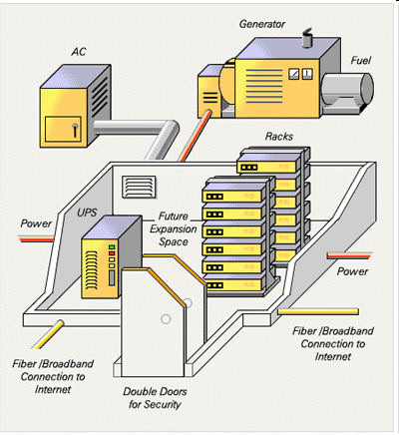

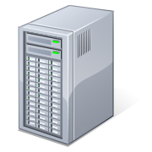
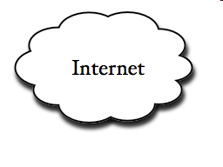
Protecting the IT Infrastructure
Critical System Event Data
ConsoleWorks
Server
Disk Errors
Application Errors
Critical Event?
System OK
Secure
Remediation
Path
Door Opened
Secure Storage
Of All Events
Secure Remediation Path
Notes:
We do not conpete with products like BMC, Tivoli, HP OV,….
They only monitor, they do not provide path to asset for remediation action

Slide 39
Protecting the IT Infrastructure
Critical System Event Data
Serial or TELNET
ConsoleWorks
Server
SNMP Traps
SYSLOG
Critical Event?
Windows Events
Secure
Remediation
Path
SSH/PKI
Secure Storage
Of All Events
Secure Remediation Path

Slide 40
Theory of operation
Maintains a persistent connection to an asset’s communication port
Manages any information source that sends text data out its console port and allows connections through it
Monitors any information source that sends text data using Syslog or SNMP traps
Scans incoming unsolicited text and compares it to the knowledge base, declaring events when a match is made
Logs all communication to and from the asset
Notes:
serial console port, service processor, baseboard management controller (BMC), management frontend, chassis management system

Slide 41
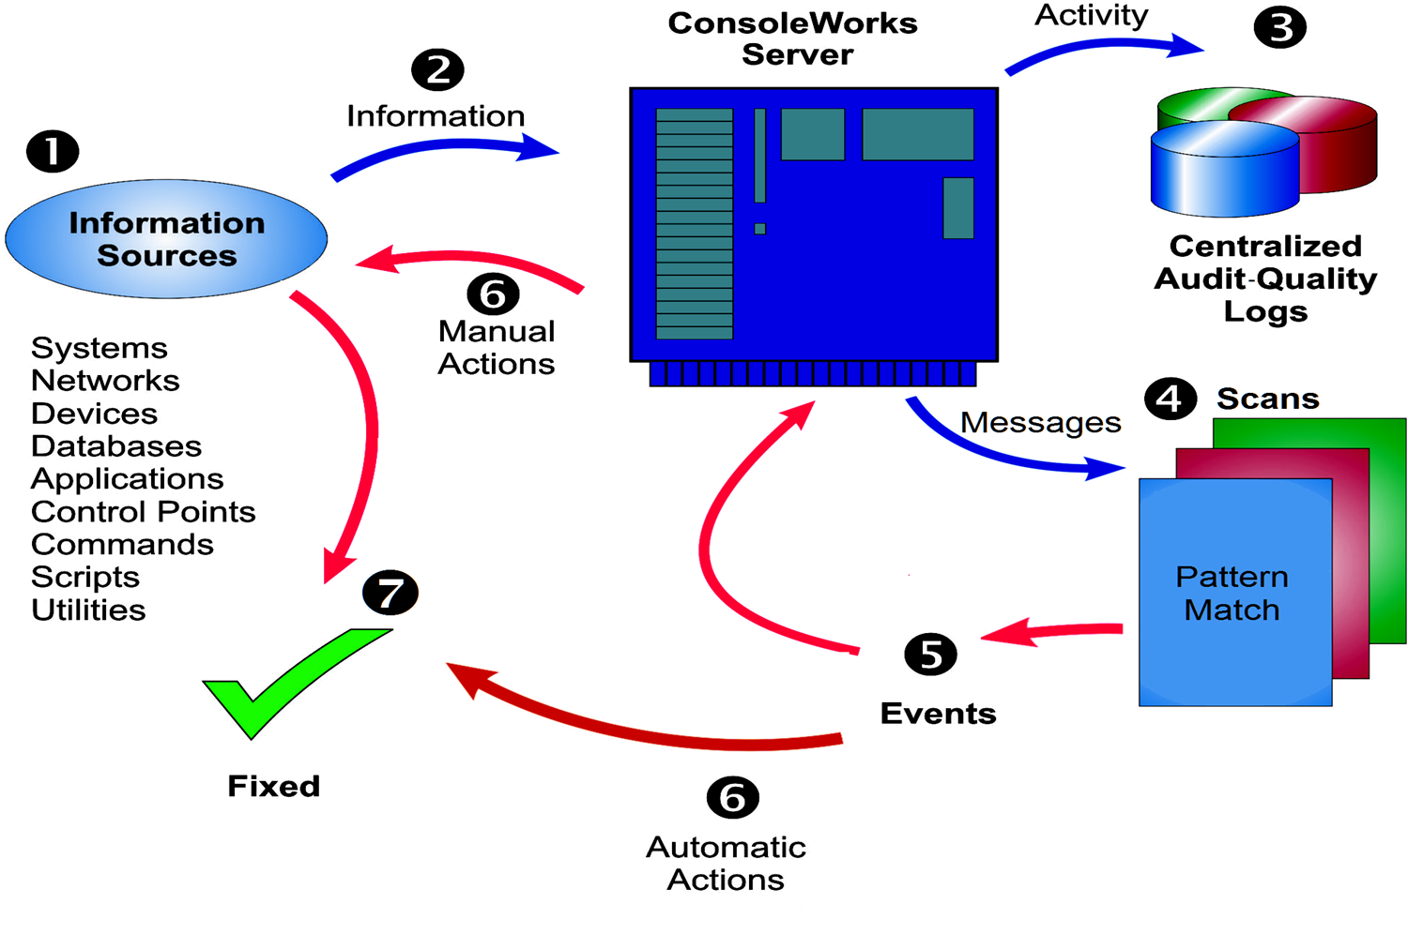
Overview
Notes:
1 The information sources that make up your computing infrastructure provide
a constant stream of data on their status: how things are, what they and the
things they know about are doing, and what’s being done to them.
2 ConsoleWorks captures those messages,
3 logs all activity on the managed
infrastructure, and
4 scans the information for issues of interest. When it finds
an issue,
5 ConsoleWorks declares (and logs) an Event, sends out alerts, and
6 initiates pre-configured automatic Actions to fix the problem. For more
complex problems, ConsoleWorks provides
6 access to the troubled asset for
manual remediation 7.
Note. All the remediation activity is logged.

Slide 42
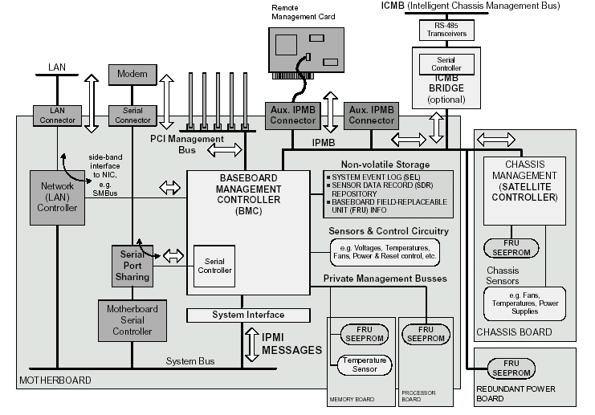
IT Infrastructure Technology Stack
END USER APPLICATIONS
PRODUCTION / WEB APPLICATIONS
ABOVE GREEN LINE
REQUIRE
NETWORK
ACCESS & SYSLOG
SNMP FUNCTIONS
TRADITIONAL LOG MANAGEMENT SOLUTIONS
SECURITY MONITORING SOLUTIONS
PERFORMANCE MONITORING SOLUTIONS
DATABASE SOLUTIONS
NETWORK (SNMP, SYSLOG, TELNET, SSH)
LOCAL STORAGE & ENVIRONMENT ESTABLISHED
OPERATING SYSTEM
DRIVERS
BIOS
FIRMWARE
B M C
Console Access
Outside In Model
BARE METALACCESS
Mgmt from point of power on
Nothing else on
Notes:
Take a look at where in this technology stack the service processor is relative to the log management solution.
Lets review it a bit closer….NEXT SLIDE
We log and can do the stuff with the system
We are NOT reliant on health of system!
We manage IT infrastructure from the foundational level, from the point power is ON, but nothing else is on!!

Slide 43
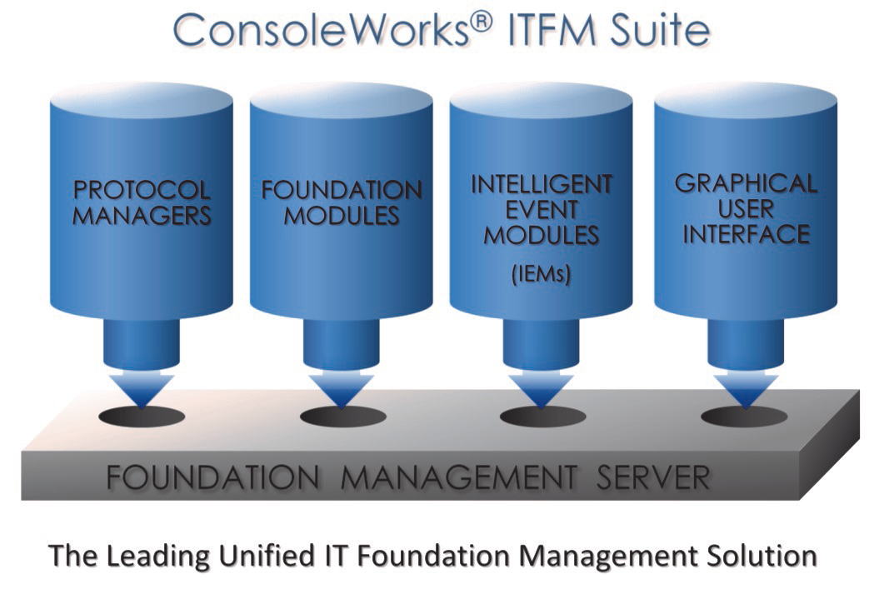
ConsoleWorks® Foundation Management Server
Provides information flow processing, business rule execution, pattern-matching execution, role-based security, and log file generation for all modules
Handles all input and output, serving this data up to modules as needed.
Optimized processing engine specifically designed to handle extremely high volume I/O traffic
Ability to “sense and respond” to events in real-time measured in milliseconds.

Slide 44
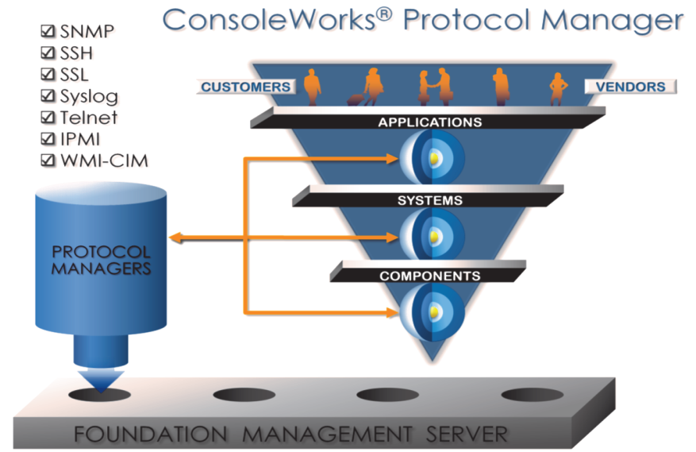
ConsoleWorks® Protocol Manager
Establishes and maintains connections to information flows
  generated by hardware, software and other intelligent devices.
Bridge between the many different types of communication channels in the IT Infrastructure and the Foundation Management Server.
Supported protocols include:
  SNMP, SSH, SSL, Syslog, Telnet, IPMI, WMI-CIM, and custom serial interfaces
Enables connection to information from virtually anywhere
For bidirectional interfaces, remediation, maintenance and repair actions based on automated business rules and user-entered actions possible

Slide 45
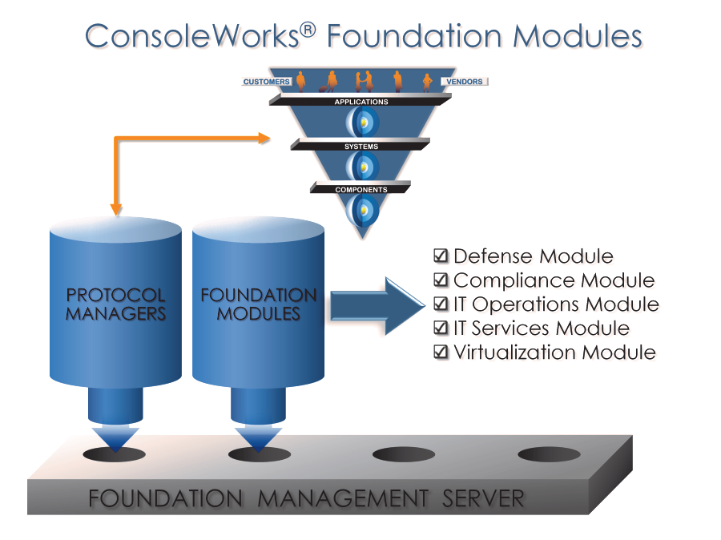
ConsoleWorks® Foundation Modules
Defense Module: Insider Threat protection
Compliance Module: regulatory compliance policy
IT Operations Module: capture and organize events
IT Services Module: identify and capture information flows and event patterns
Virtualization Module: includes support for hypervisors and Virtual Machines
Notes:
Module is a marketing name for structure
Usgae by customers of CW ITFM created the „modules“

Slide 46
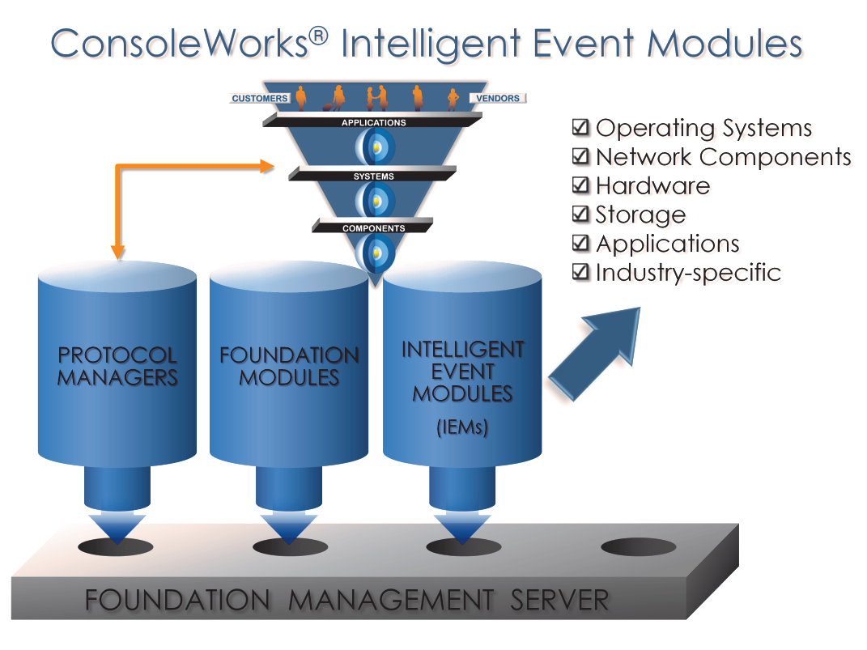
ConsoleWorks® Intelligent Event Modules
Associate descriptive text to the cryptic event codes
  generated by devices, operating systems, other IT components
  IEMs associate recommended actions
  Information available “on-demand” (embedded)
  Additional information can be added (adaptive)
More than 85 Intelligent Event Modules available
Notes:
Predefined events (IEM) come directly from the vendors!
Adaptive = stuff from log file on how problem was solved can be added, so next time time is saved!!

Slide 47
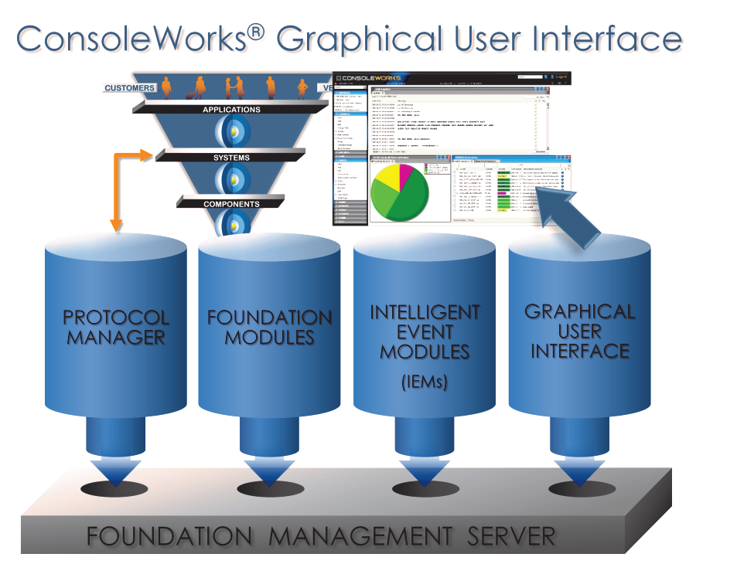
ConsoleWorks® Graphical User Interface
Graphical user interface to the IT Operations Foundation
Web UI
Allowing access from anywhere
Supports IT out-sourcing models, centralized support department, or flex (home office) working arrangements
Provides comprehensive Business Intelligence capabilities through graphical Dashboards and Reports
Command line interface also

Slide 48
Platforms
OPERATING SYSTEM HARDWARE PLATFORM
HP OpenVMS 8.2 or later Alpha™, Itanium™
Windows Server 2003, 2008 Intel®, AMD
Sun™ Solaris™ 8 or 10 UltraSPARC®
Red Hat® Enterprise Linux® Server 4.0
or later Intel, AMD
Novell® SUSE™ Linux Enterprise Server 9.0
or later Intel, AMD
Ubuntu latest Intel, AMD
Debian latest Intel, AMD
Notes:
Bis auf windows gibt es überall 64bit native versions

Slide 49
Special offers / Late news

Slide 50
ConsoleWorks PCM Upgrade Program
Still have a version of Polycenter ConsoleManager (PCM) in use?
Well 10+ years is a long time to rely on an unsupported product!
Plus, can you imagine how things have progressed since PCM was last updated? We certainly can…
That’s why we’re offering a FREE CONSOLEWORKS SERVER LICENSE to replace PCM—and to get you “up to the minute” with the most advanced Console Management product on the planet Earth…..
…..
FREE SERVER LICENSE!
Valid until Dec 31st 2010

Slide 51
ConsoleWorks® Virtualization Foundation for VMware
ConsoleWorks – Leveraging the VMware Virtual Serial Port
The inclusion of the Virtual Serial Port in VMware vSphere 4.1 provides an important technical capability for enhanced management of virtual environments.
The new release of the ConsoleWorks Virtualization Foundation leverages this capability to deliver enterprise-class VM and vCenter compliance and security capabilities as well as further optimizing virtual environment IT operations.
Utilizing the vSphere 4.1 Virtual Serial Port capability, the latest release of the ConsoleWorks Virtualization Foundation (for VMware) is delivered with new management enhancements through the ConsoleWorks Virtual Serial Port Concentrator.
The ConsoleWorks Virtual Serial Port Concentrator provides the means to capture and aggregate all events and actions that are taken on virtual machines and vCenters in a secure manner that meets enterprise-class security and compliance requirements. In addition, ConsoleWorks can now extend all of the benefits of the ConsoleWorks ITFM Suite to virtual environments. These include: infrastructure security, augmenting compliance at the IT infrastructure level, decreasing IT infrastructure operating costs and increasing the ability to deliver on IT services (Service Level Agreements).

Slide 52
References

Slide 53
Reference Customers
Bank of America, Bank of England, BNY Mellon, Commerzbank, BNP Paribas, AIG, Handelsbanken, …
Direct TV, British Library, …
Pfizer, Lahey Clinic, UCSF Medical Center, Mayo Clinic,…
Fairchild, TriQuint Semiconductor, ESA,…
Verizon

Slide 54
Questions

Slide 55
TDi Technologies®
Your business is built on IT
The Global Leader in
IT Foundation Management
Notes:
55

